Slide 1
HOW TO REDUCE YOUR ALLERGY RISK.
Patient information about composite dental filling materials
saremco.ch

Slide 2
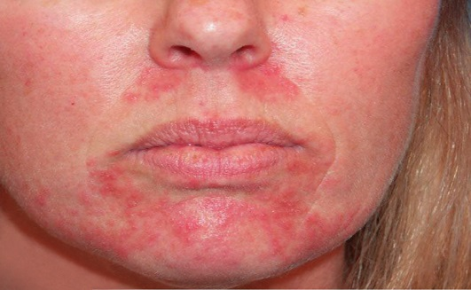
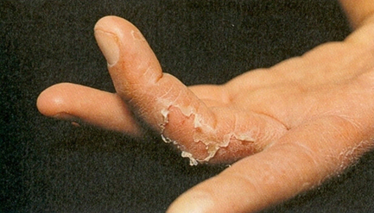
DID YOU KNOW?
More and more patients are reacting to composite dental filling materials with side effects.
Already one in 25 patients are affected.*
* Prof. Dr. Dr. F.-X. Reichl, Clinic for Conservative Dentistry and Parodontology, Munich (Germany). Swiss Dental Journal 12-2014
saremco.ch

Slide 3
DID YOU KNOW?
Frequent triggers are the ingredients TEGDMA & HEMA.
These are normally used in dental filling materials.
HEMA
TEGDMA
saremco.ch

Slide 4
Advantages of SAREMCO Products
demonstrably free from TEGDMA and HEMA
no side effects from these ingredients
vital tooth colors
long-lasting and stable
Swiss quality product
saremco.ch

Slide 5
There are also TEGDMA and HEMA free adhesives for fixed braces (brackets & retainers)
Developed by SAREMCO Available at DENTAURUM
saremco.ch

Slide 6
Consult your practice about biocompatible dental materials!
saremco.ch

Slide 7
YOUR HEALTH
IS IMPORTANT TO US

Slide 8
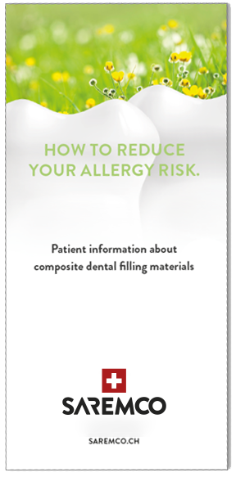
Please take our brochure home with you!

