Slide 1
HOW TO REDUCE YOUR ALLERGY RISK.
Patient information about composite dental filling materials

Slide 2
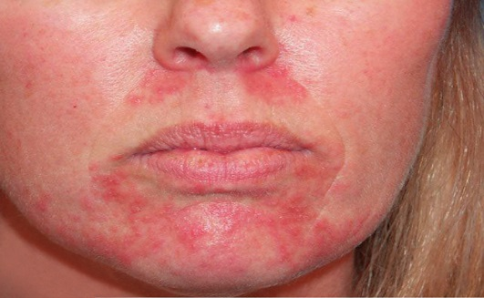
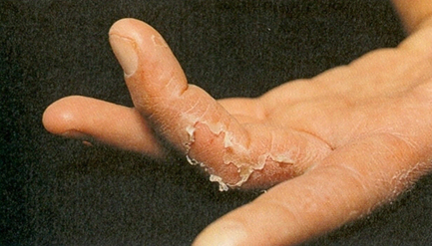
Did you know?
More and more patients are reacting to composite dental filling materials with side effects.
Already one in 25 patients are affected.

Slide 3
Did you know?
Frequent triggers are the ingredients TEGDMA & HEMA.
These are normally used in dental filling materials.
HEMA
TEGDMA

Slide 4
What are the advantages of Saremco products?
Free from TEGDMA and HEMA
No side effects from these ingredients
Vital tooth colours
Long-lasting and stable
Swiss quality product

Slide 5
There are also TEGDMA and HEMA fee adhesives for fixed braces (brackets & retainers)
Developed by SAREMCO Available at DENTAURUM

Slide 6
Consult your practice about biocompatible dental materials!

Slide 7
YOUR HEALTH IS IMPORTANT TO US.

Slide 8
Please take our brochure home with you!

